Slide 1

Classification of Healthcare Risk Factors using Machine Learning
Students: Mohammad Atiyeh, Yahya Jarrar, Mohammad Baker and Mohammad Abo Alrob
Supervisor: Dr. Mohammad Awad

Slide 2
Introduction
Valuable Information
Pattern Discovery
Risk Classification
Healthcare data contains valuable information about patient risk.
Machine learning helps discover patterns in health data.
This project applies machine learning to classify healthcare risk.

Slide 3
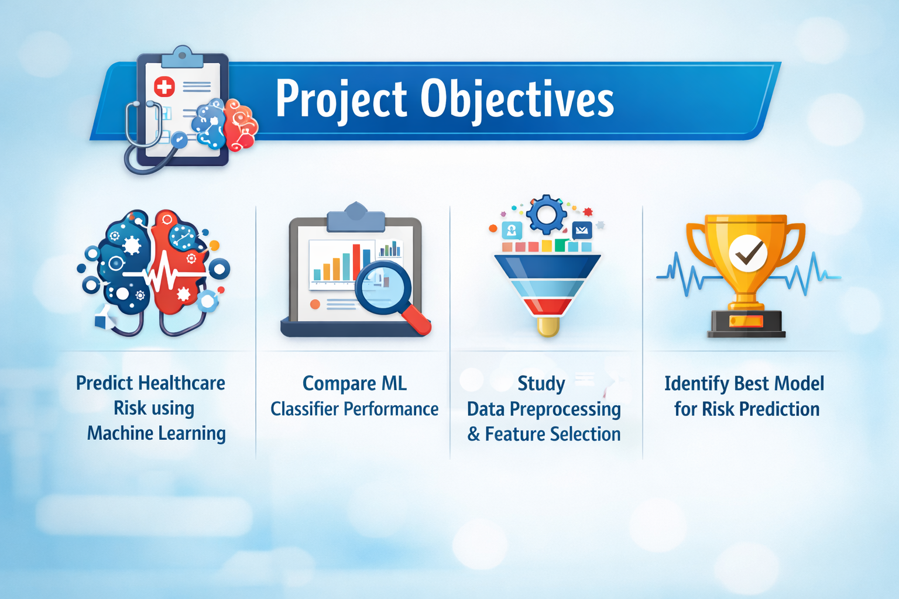

Slide 4
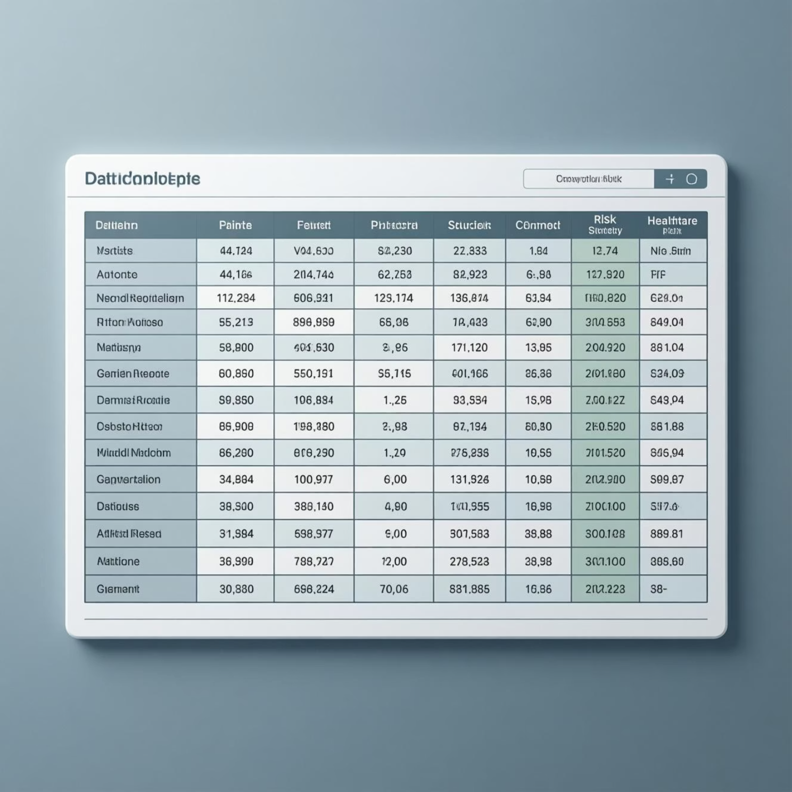
Dataset Overview
30K
18
Records
Columns
Around 30,000 records
18 columns (17 features + 1 target)
Target with two classes: Risk (0,1)
Mixed feature types
Missing values existed

Slide 5
Handling Missing Values
16,645 records had missing values.
Two methods were applied:
Method 1
Method 2
Removing records with missing values.
Imputing missing values using mean / most frequent value.
Applied using Orange Data Mining.

Slide 6
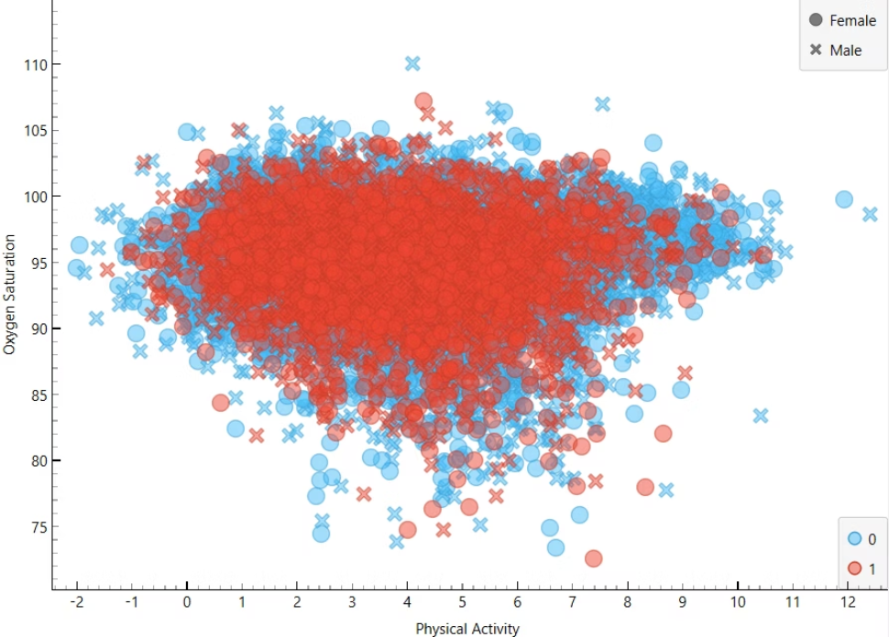
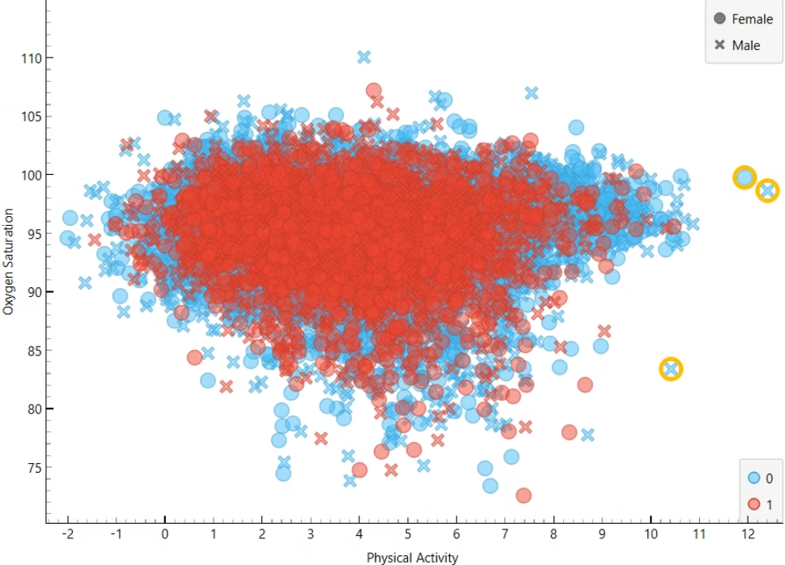
Outliers Detection
Outliers negatively affect model performance.
Detected using:
- Scatter plots
- One-Class SVM / LOF
Outliers were removed to improve data quality.

Slide 7
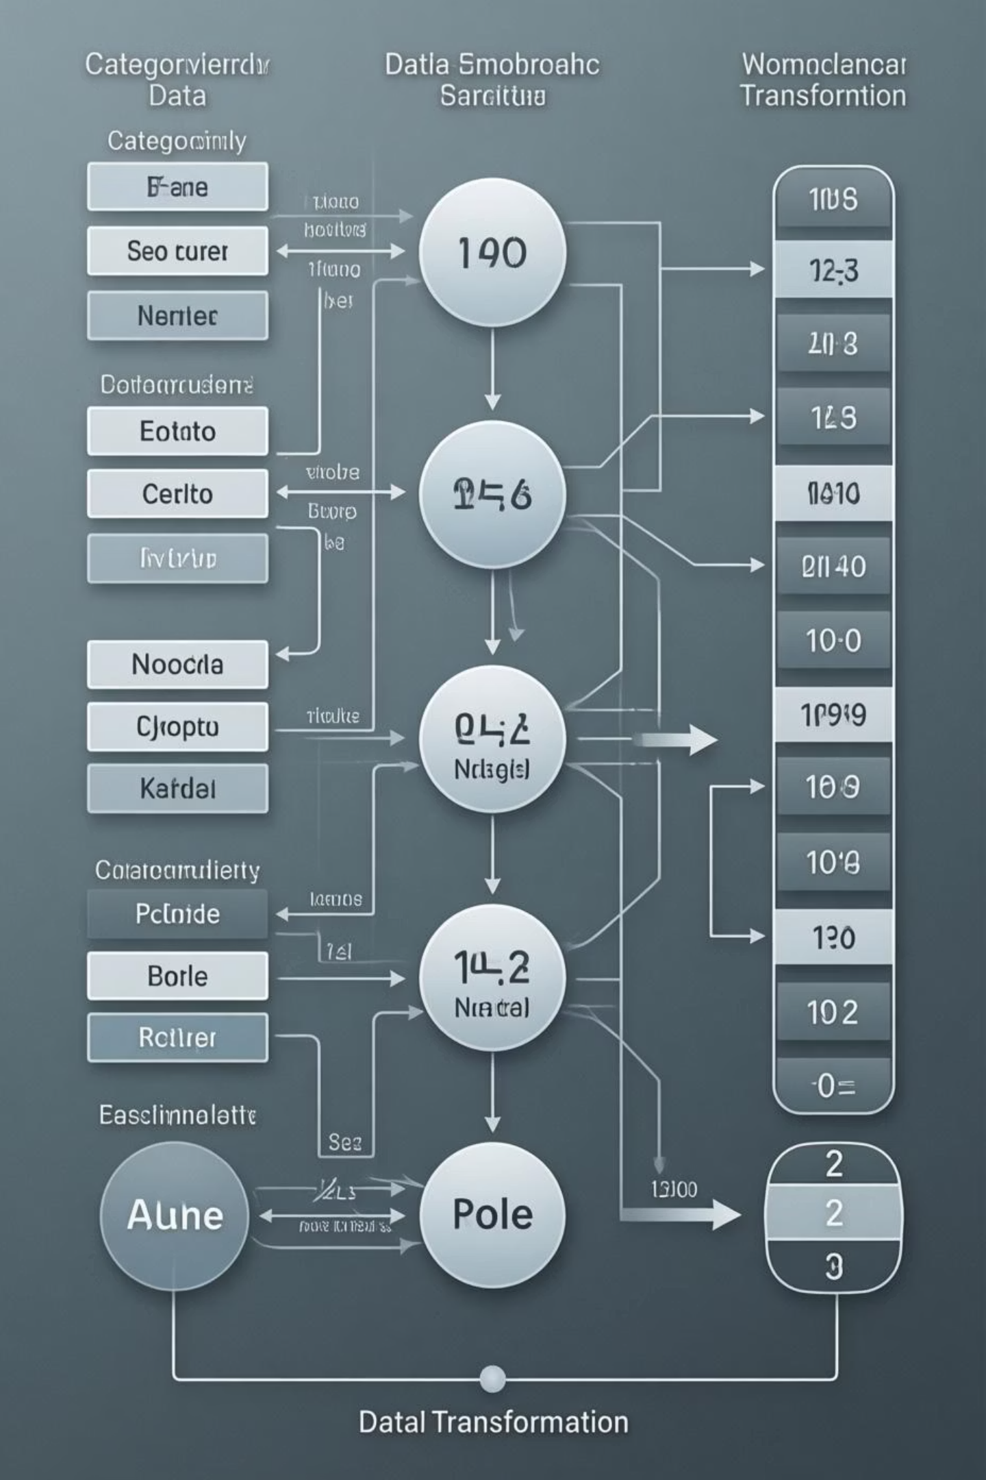


Data Transformation
Encoding + Normalization
Data transformation prepares data for machine learning.
Encoding
Converted categorical features to numerical.
Normalization
Min–Max scaling to range [0,1].

Slide 8
Feature Selection
Feature selection improved model performance.
Removed features:
Medical Condition
Length of Stay
Alcohol
Gender

Slide 9






Model Evaluation
Models used:
Support Vector Machine (SVM)
k-Nearest Neighbors (KNN)
Random Forest
Naive Bayes
AdaBoost
Neural Network

Slide 10
Model Results
Performance metrics for various machine learning models:
MODEL
AUC
ACCURACY
F1
PRECISION
RECALL
SVM
0.53
0.60
0.58
0.56
0.605
KNN
053
0.70
0.60
0.60
0.701
Random Forest
0.59
0.69
0.63
0.63
0.696
Naive Bayes
0.60
0.69
0.63
0.63
0.697
AdaBoost
0.52
0.60
0.60
0.61
0.605
Neural Network
0.60
0.70
0.58
0.50
0.709

Slide 11
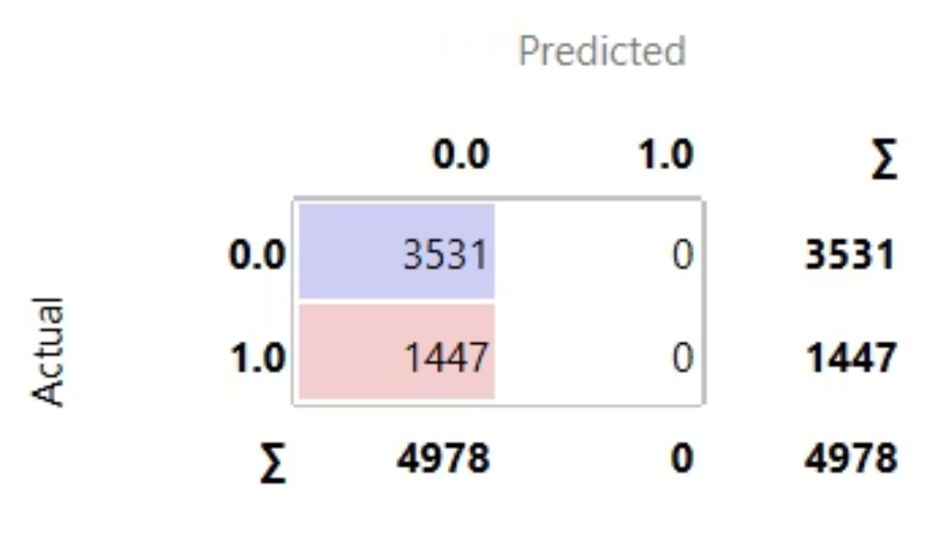
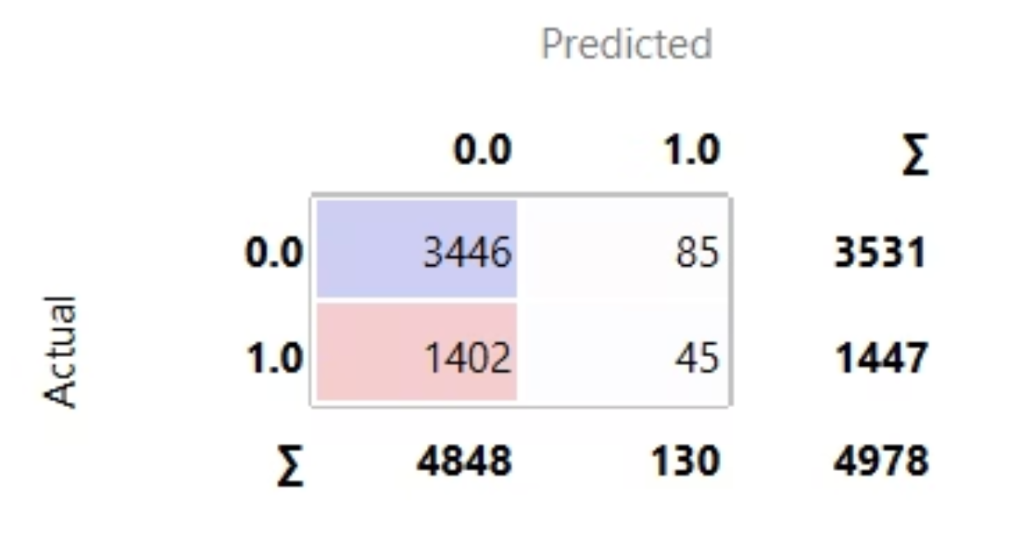
Confusion Matrix
Confusion matrices are used to analyze classification performance.
Results are shown for the best performing models:
Neural Network
k-Nearest Neighbors (KNN)
Special focus on reducing false negatives, which is critical in healthcare risk prediction.
Neural Network confusion matrix
KNN confusion matrix

Slide 12
Results Summary
The machine learning models achieved a reasonable classification accuracy of around 70%.
Neural Network and KNN showed the best performance among the tested models.
Data preprocessing and feature selection contributed to improving model stability and performance.
Although high accuracy is desirable in healthcare applications, the best achieved accuracy was approximately 70%. This indicates that the main limitation lies in the dataset characteristics, despite applying proper preprocessing and modeling techniques.

Slide 13
Conclusion
This project explored the use of machine learning for classifying healthcare risk factors.
Data preprocessing, outlier removal, and feature selection played a critical role in improving the results.
The proposed approach demonstrates the potential of machine learning as a decision support tool in healthcare.

Slide 14
Thank You
Thank you for your attention.
Questions?

